Slide 1
OPIM 5604
Predictive Modeling
Logistic Regression
Jennifer Eigo, Instructor in-Residence

Slide 2
Topics
Logistic Response Function
Building the Model
Variable Selection
Interaction Terms

Slide 3
Logistic Regression
Extends idea of linear regression to situation where outcome variable is categorical
Widely used, particularly where a structured model is useful to explain (=profiling) or to predict
We focus on binary classification
  i.e. Y=0 or Y=1

Slide 4
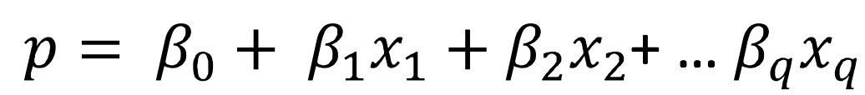
Why not use Linear Regression?
Goal: Find a function of the predictor variables that relates them to a 0/1 outcome
p = probability of belonging to class 1
Need to relate p to predictors with a function that guarantees 0 <= p <=1
Standard linear function (as shown below) does not constrain the probability:
q = number of predictors

Slide 5
The Solution? The Logit
Instead of Y as outcome variable (like in linear regression), we use a function of Y called the logit
Logit can be modeled as a linear function of the predictors
The logit can be mapped back to a probability, which, in turn, can be mapped to a class

Slide 6
What is the Logit?
The logit is the same as the natural log of the odds
Logit = log(Odds)
The logit relates linearly to the predictor variables.

Slide 7
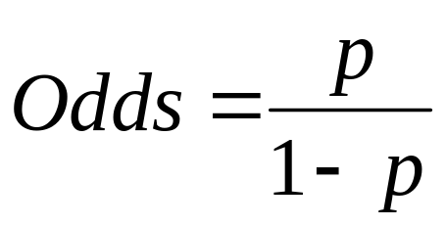
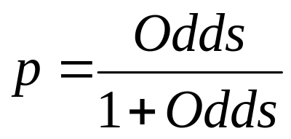
What are the Odds?
The odds of an event are defined as:
p = probability of event
Or, given the odds of an event, the probability of the event can be computed by:
If there’s an 80% chance that it will rain, you could say that there are 4 to 1 odds that it will happen.
p = 0.8 Odds = 0.8/0.2 = 4

Slide 8
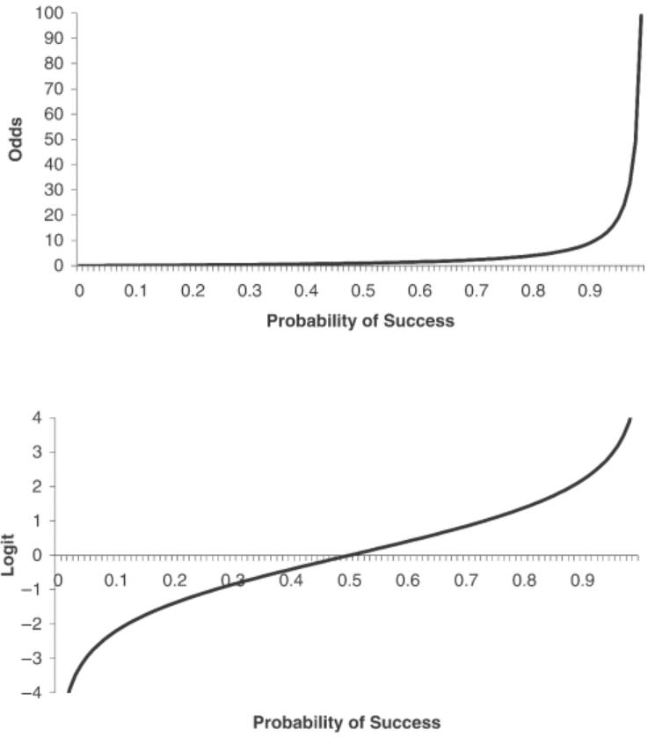
How do these all relate?
Probability | Odds | Log Odds
0.0001 | 0.000 | -9.210
0.001 | 0.001 | -6.907
0.01 | 0.010 | -4.595
0.1 | 0.111 | -2.197
0.2 | 0.250 | -1.386
0.3 | 0.429 | -0.847
0.4 | 0.667 | -0.405
0.5 | 1.000 | 0.000
0.6 | 1.500 | 0.405
0.7 | 2.333 | 0.847
0.8 | 4.000 | 1.386
0.9 | 9.000 | 2.197
0.99 | 99.000 | 4.595
0.999 | 999.000 | 6.907
0.9999 | 9999.000 | 9.210
https://www.statisticshowto.datasciencecentral.com/log-odds/

Slide 9
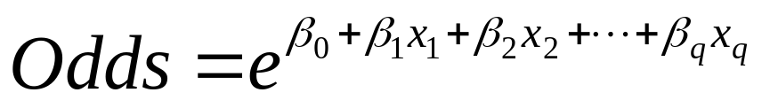
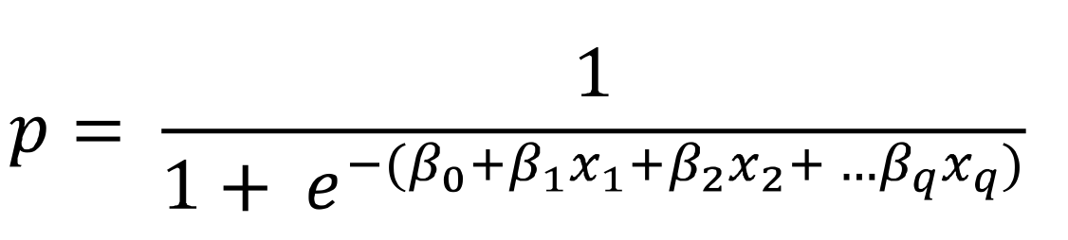
Pulling it all together…
We can use a linear combination of variables to solve for the logit
With some algebra we can relate probability to the predictors, by way of the odds

Slide 10
Which gives us the…
Logistic Response Function
Parameters are estimated during training using Maximum Likelihood Estimation (MLE)
Attempts to output a very high logit for class 1 and a very low logit for class 0 to create class separation
High logit leads to high probabilities; low logit leads to low probabilities

Slide 11
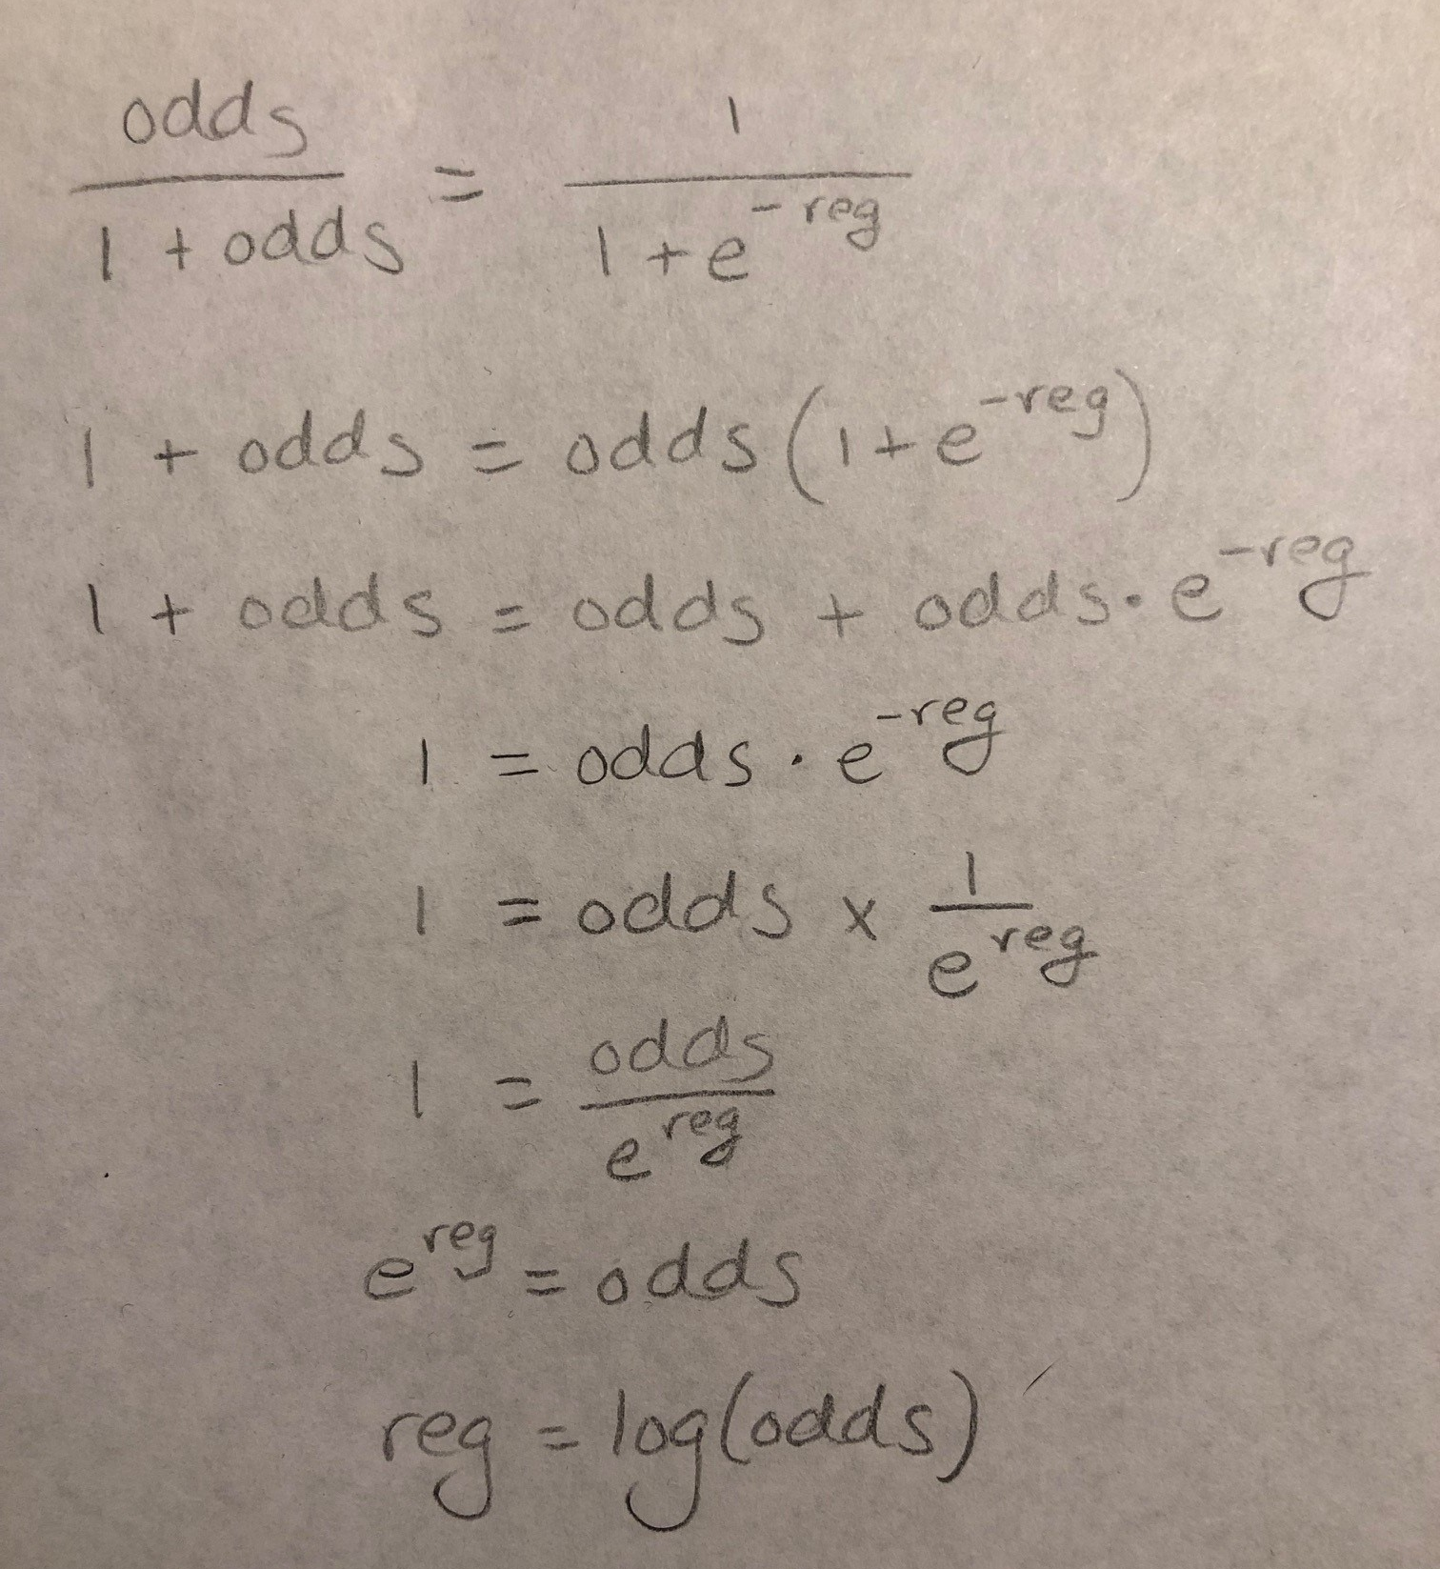
Connecting it all with Algebra
Sub for p
Cross multiply
Distribute odds on
the right
Subtract odds from
both sides
Remove negative
exponent
Multiply both sides by
e^reg
Take the log of both
sides

Slide 12
Logistic Regression

Slide 13
Logistic Regression
Partition the data
Define the target variable (y)
Define the predictor variables (x)
Fit the model
Evaluate model performance on each partition

Slide 14
Personal Loan (Universal Bank)
Outcome variable: accept bank loan (no = 0/yes = 1)
Predictors: Demographic info, and info about the customer relationship with the bank

Slide 15

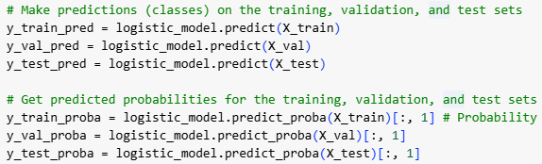
Fit the Model
Define the model that we are using
Calculate the best intercept and coefficients to create the regression formula
Apply the formula to each row

Slide 16
Interpret the Coefficients
The logistic regression formula is formed by the coefficients
Positive values increase the likelihood of the 1 prediction
Negative values decrease the likelihood of the 1 prediction
Can’t directly interpret unit change impact of coefficients

Slide 17
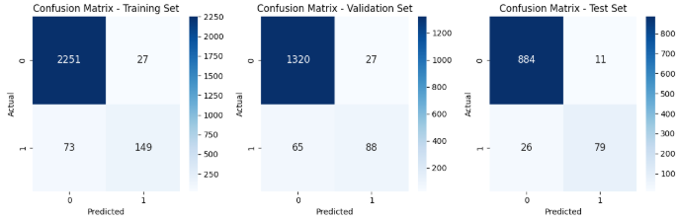
Check Performance
Model performance is measured by a variety of metrics, all calculated from the confusion matrix
Performance is reported for each partition separately to check for overfitting

Slide 18
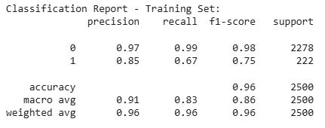
Check Performance
Sample Classification Report for Training
  Total Accuracy = 0.96
  Precision = 0.85 (how reliable is the 1 prediction?)
  Recall = 0.67 (how many 1s were identified?)
  F1 Score = 0.75 (harmonic avg of two above)
  Support = 222 (how many 1s the model predicted)

Slide 19
Variable Selection

Slide 20
Selecting Subsets of Predictors
Goal: Find a parsimonious model (the simplest model that performs sufficiently well)
  More robust
  Higher predictive accuracy
Manual Approach
  Evaluate P values to identify important variables
Popular Subset Selection Algorithms
  Forward selection
  Backward elimination
  Mixed Stepwise

Slide 21
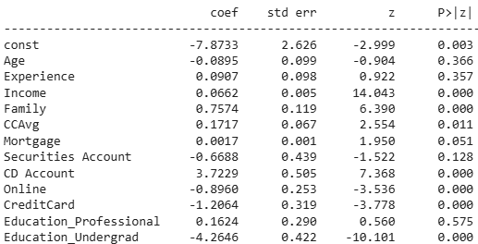
Check for Variable Significance
P values measure statistical significance of each predictor
Tiny P values (below 0.05) are the best!

Slide 22
Interaction Terms

Slide 23
Interaction Terms
Capture how variables can have a combined effect on the target
We know income and family size both impact a person’s decision about the loan
But what about the combined effect?
Solution:
  Multiply the two terms together
  Check for statistical significance
  Check for model performance improvement

Slide 24
Summary
Logistic regression is similar to linear regression, except that it is used with a categorical response
It can be used for explanatory tasks (=profiling) or predictive tasks (=classification)
The predictors are related to the response Y via a nonlinear function called the logit
As in linear regression, reducing predictors can be done via variable selection
Logistic regression can be generalized to more than two classes (ordinal or multinomial)

